Slide 1

David M. Kroenke and David J. Auer Database Processing Fundamentals, Design, and Implementation
Appendix J:
Business Intelligence Systems

Slide 2
Chapter Objectives
To learn the basic concepts of business intelligence (BI) systems
Learn the basic concepts of reporting systems and data mining

Slide 3
Business Intelligence (BI) Systems
Business intelligence (BI) systems are information systems that assist managers and other professionals:
To analyze current and past activities.
To predict future events.
Two broad categories:
Reporting
Data mining

Slide 4
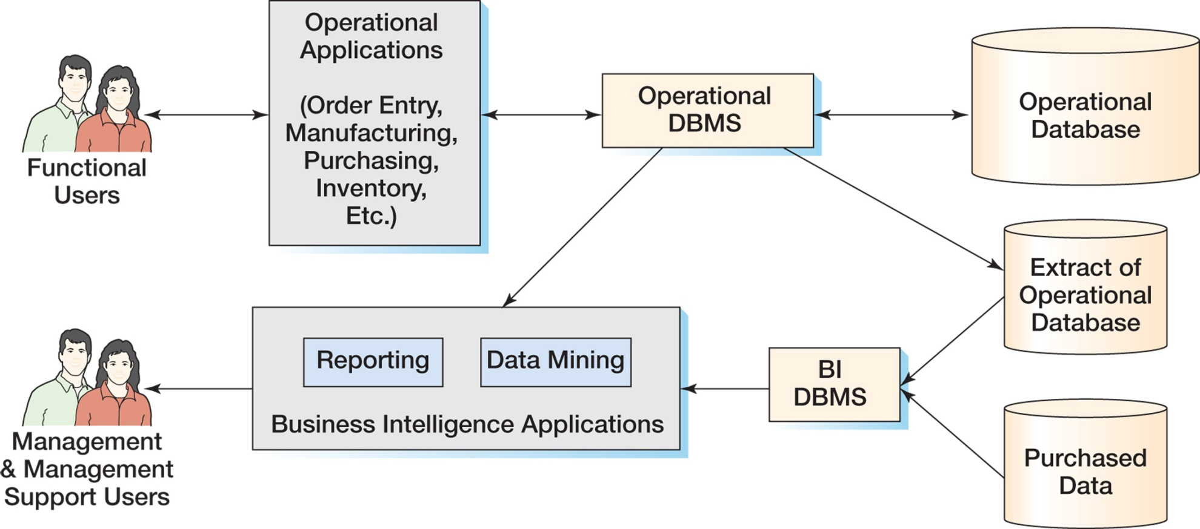
The Relationship of Operational and BI Systems

Slide 5
Data for BI Systems
BI systems obtain data in three ways:
From the operational database
Read and process data only
DO NOT insert, modify or delete operational data
From extracts from the operational database
Data is in a BI DBMS
May be a different DBMS than the operations DBMS
From data purchased from data vendors

Slide 6
Reporting Applications
Reporting system applications:
Filter
Sort
Group
Make simple calculations
Classify entities
RFM Analysis
Can be performed using standard SQL
Extensions to SQL are sometimes used
OnLine Analytical Processing (OLAP)
Summarize current business status
Compare current business status to past or future
Deal with critical report delivery

Slide 7
Data Mining Applications
Data mining applications are used to:
Perform what-if analysis
Make predictions
Facilitate decision making
Data mining applications use sophisticated statistical and mathematical techniques.
Report delivery is not as critical.

Slide 8
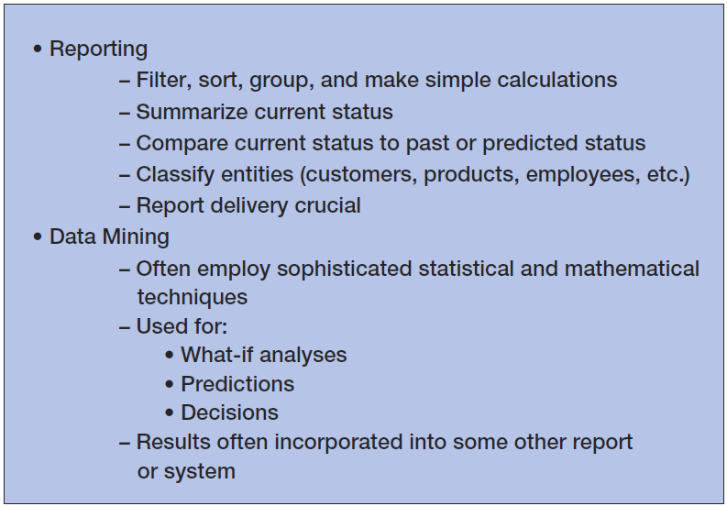
Characteristics of BI Applications

Slide 9
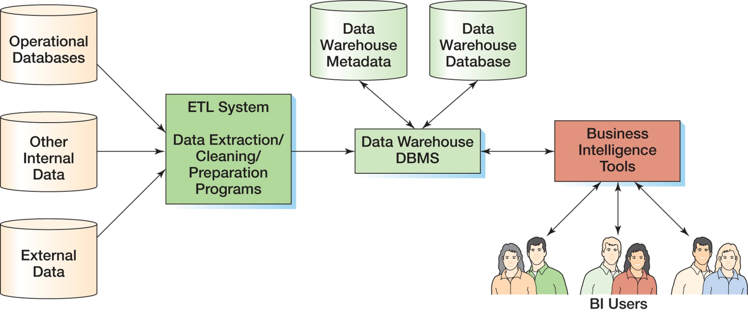
Components of a Data Warehouse

Slide 10
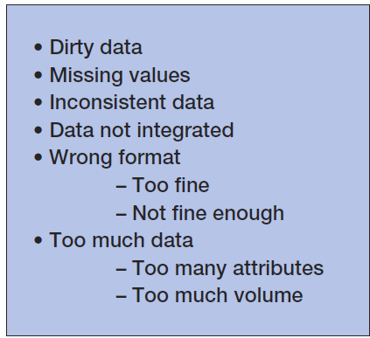
Data Warehouses and Data Marts: Problems with Operational Data

Slide 11
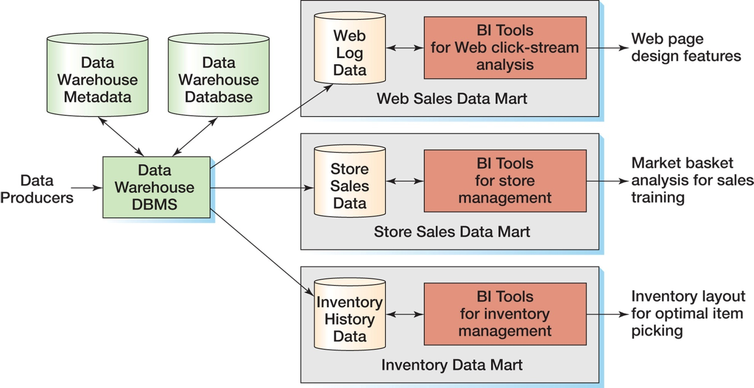
Data Warehouses and Data Marts: Data Warehouse compared to Data Marts

Slide 12
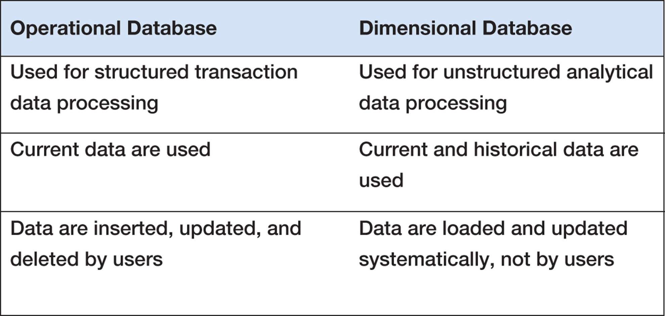
Characteristics of Operational and Dimensional Databases

Slide 13
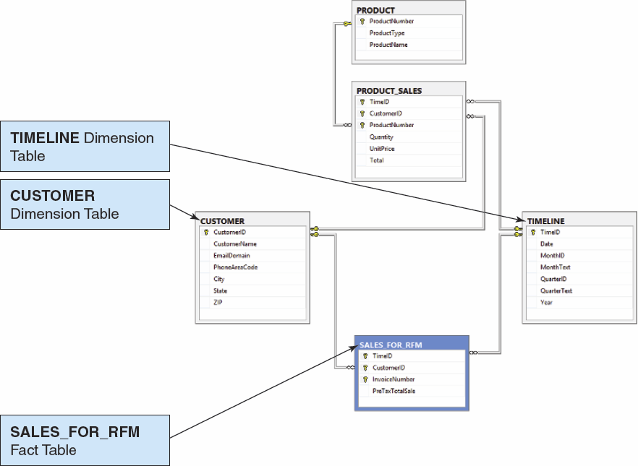
Conformed Dimensions

Slide 14
Reporting Systems: RFM Analysis
RFM Analysis analyzes and ranks customers according to purchasing patterns
R = recent (most recent order)
F = frequent (how often an order is made)
M = money (dollar amount of orders)
Customers are sorted into five groups, each containing 20% of the customers.
Each group is given a numerical value:
1 = top 20%
2, 3, 4 = each 20% in between top and bottom 20%
5 = bottom 20%

Slide 15
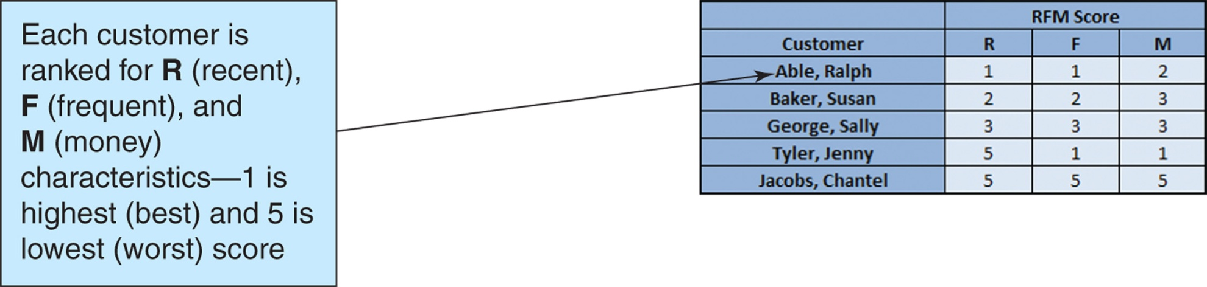
Reporting Systems: RFM Analysis

Slide 16
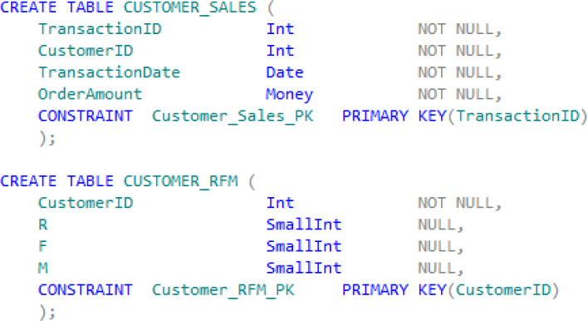
Reporting Systems: Producing the RFM Analysis—Tables I

Slide 17
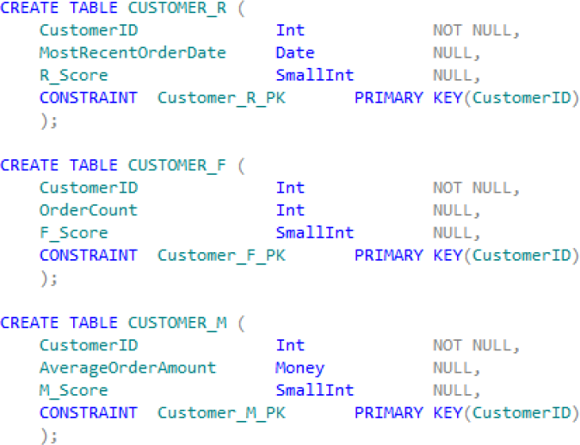
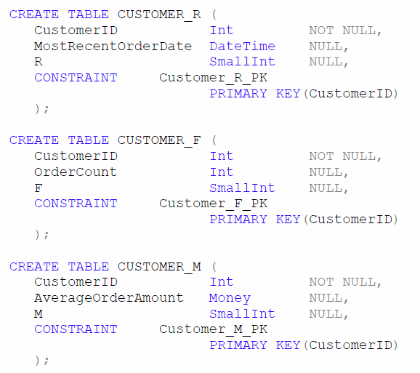
Reporting Systems: Producing the RFM Analysis—Tables II

Slide 18
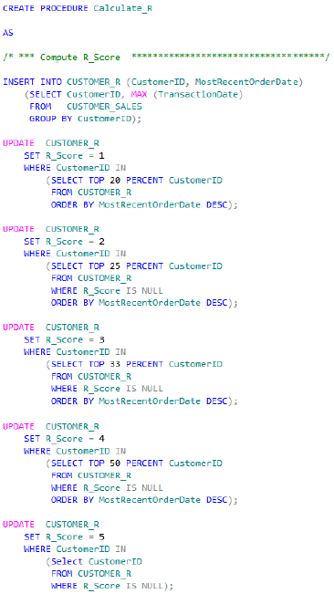
Reporting Systems: Producing the RFM Analysis: Stored Procedure Calculate_R [SQL Server]

Slide 19
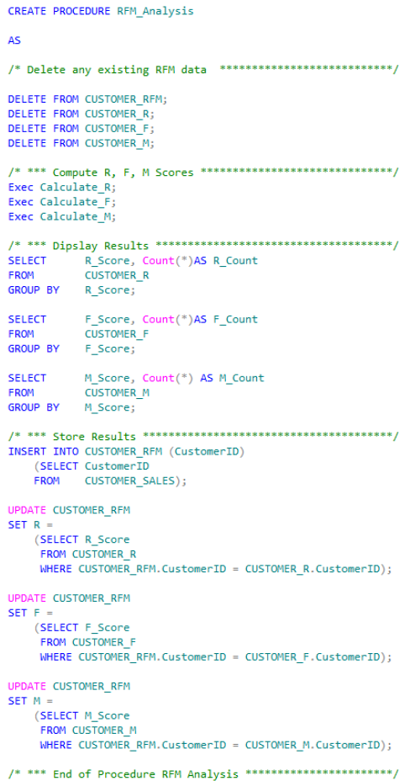
Reporting Systems: Producing the RFM Analysis: Stored Procedure RFM_Analysis [SQL Server]

Slide 20
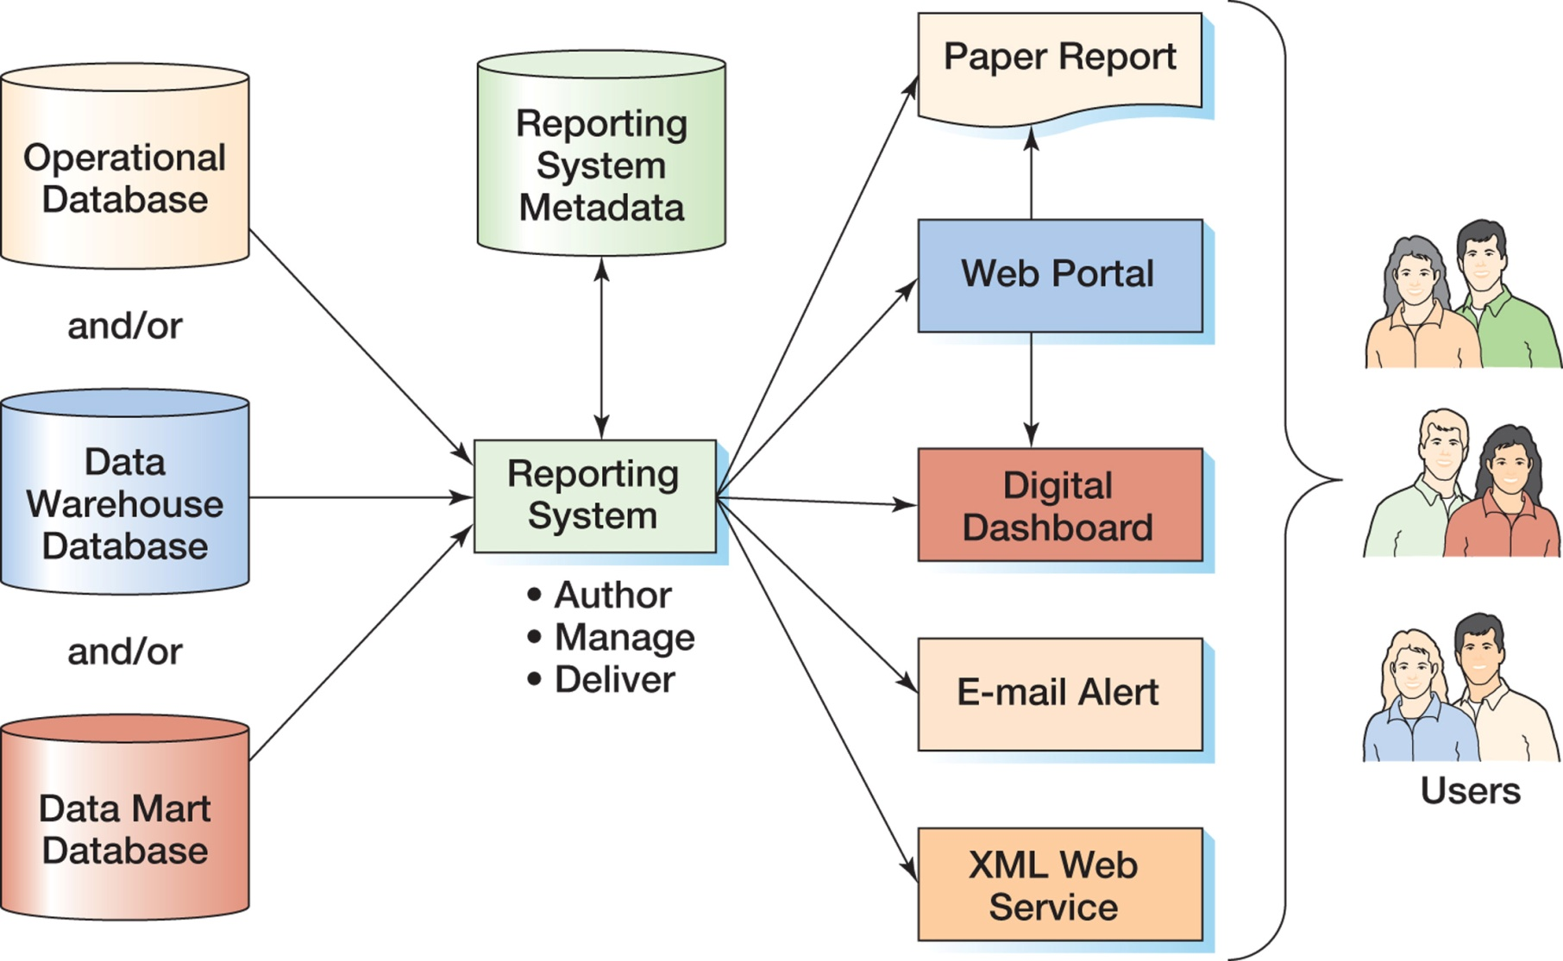
Reporting Systems: Components of a Reporting System

Slide 21
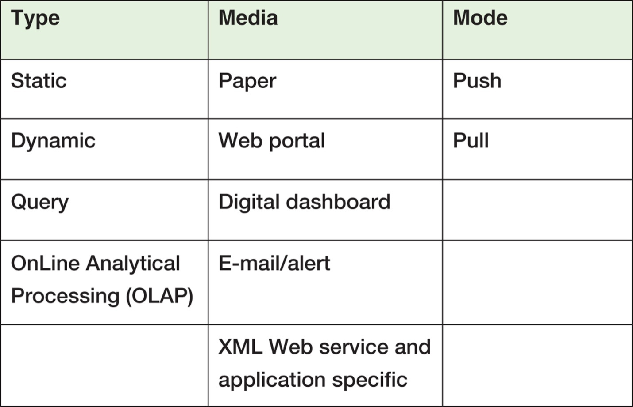
Reporting Systems: Report Characteristics

Slide 22
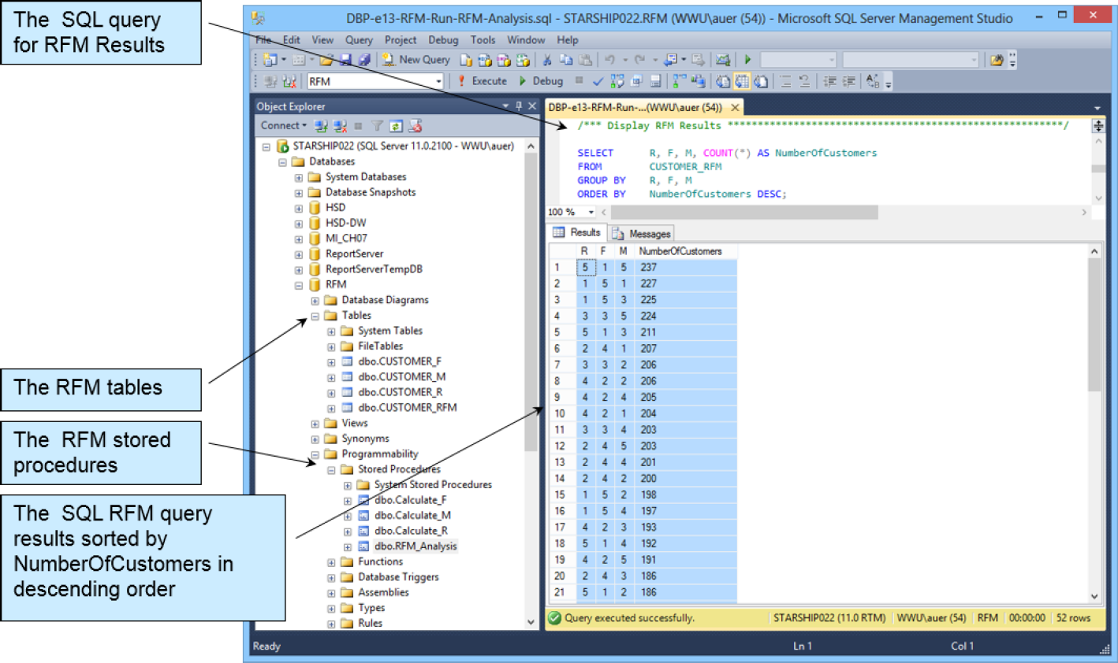
Reporting Systems: Producing the RFM Analysis: RFM Results [SQL Server] I

Slide 23
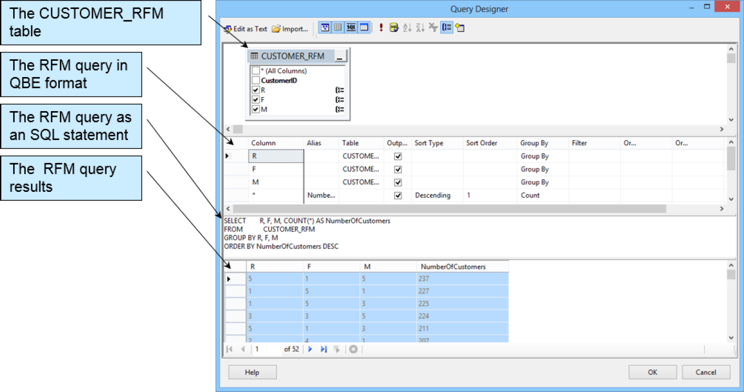
Reporting Systems: Producing the RFM Analysis: RFM Results [SQL Server] II

Slide 24
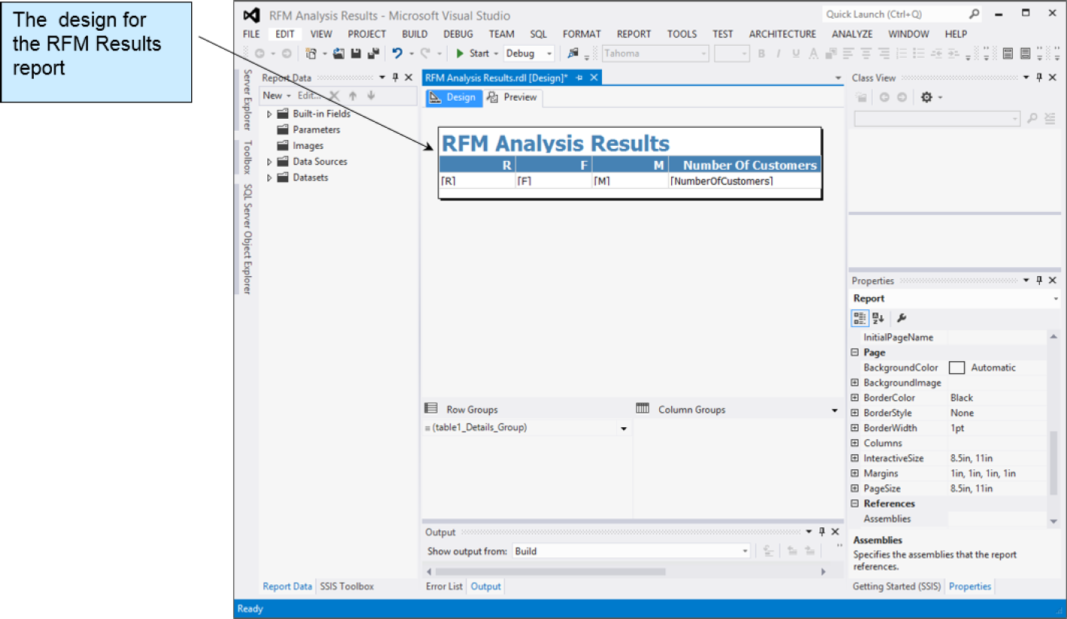
Reporting Systems: Producing the RFM Analysis: RFM Results [SQL Server] III

Slide 25
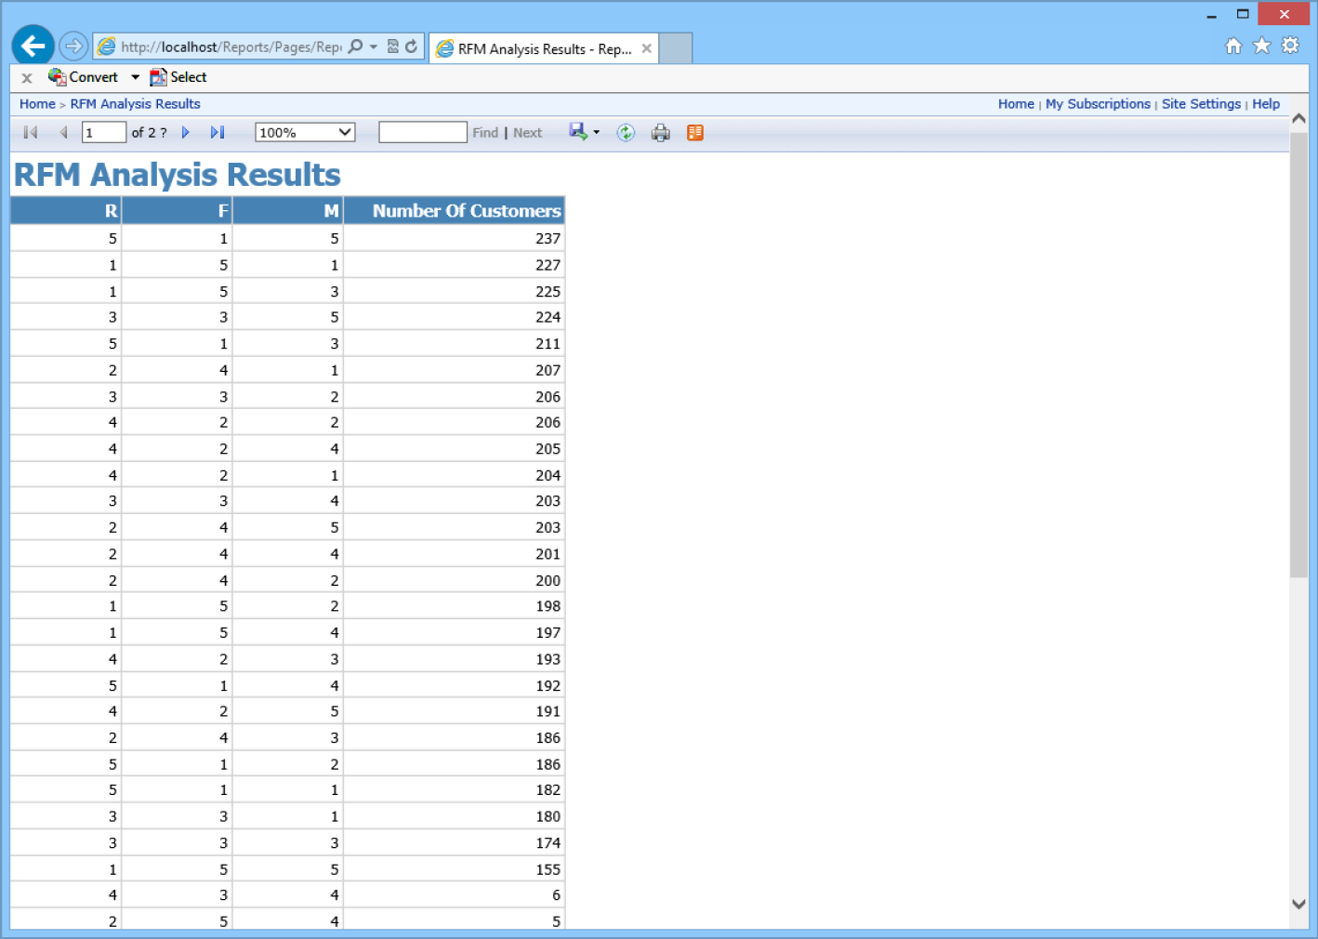
Reporting Systems: Producing the RFM Analysis: RFM Results [SQL Server] IV

Slide 26
Reporting Systems: Report System Functions
Report Authoring:
Connect to data sources
Create the report structure
Format the report
Report Management:
Define who receives what reports when and by what means
Report Delivery:
Push reports or allow them to be pulled

Slide 27
Reporting Systems: OnLine Analytical Processing [OLAP]
An OLAP report has measures and dimensions:
Measure—a data item of interest
Dimension—a characteristic of a measure
OLAP cube—a presentation of a measure with associated dimensions.
An OLAP cube can have any number of axes.
The terms OLAP cube and OLAP report are synonymous.
OLAP allows drill-down—a further division of the data into more detail.

Slide 28
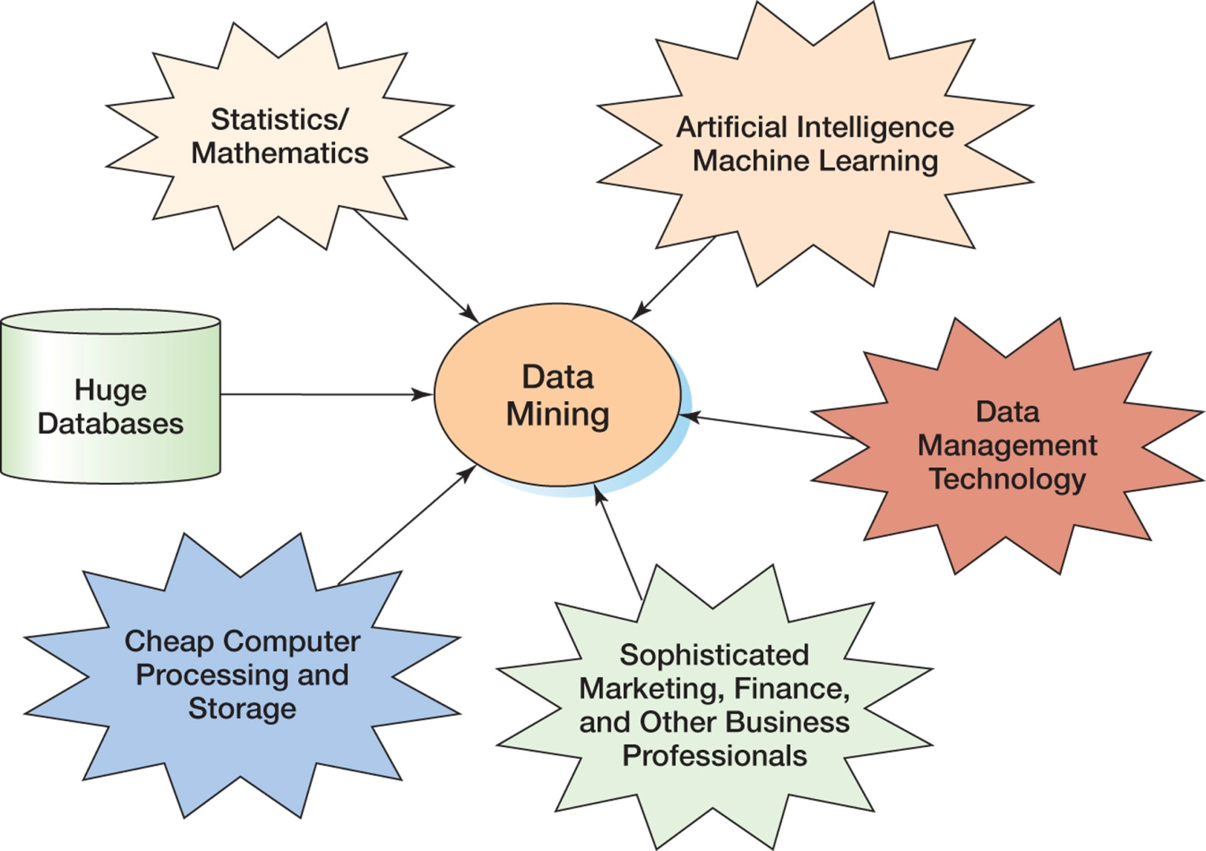
Data Mining Applications: The Convergence of the Disciplines

Slide 29
Data Mining Applications
Data mining applications use sophisticated statistical and mathematical techniques to find patterns and relationships that can be used to classify and predict.
Unsupervised data mining—statistical techniques are used to identify groups of entities with similar characteristics.
Cluster Analysis
Supervised data mining:
A model is developed.
Statistical techniques are used to estimate parameter values of the model.
Regression analysis

Slide 30
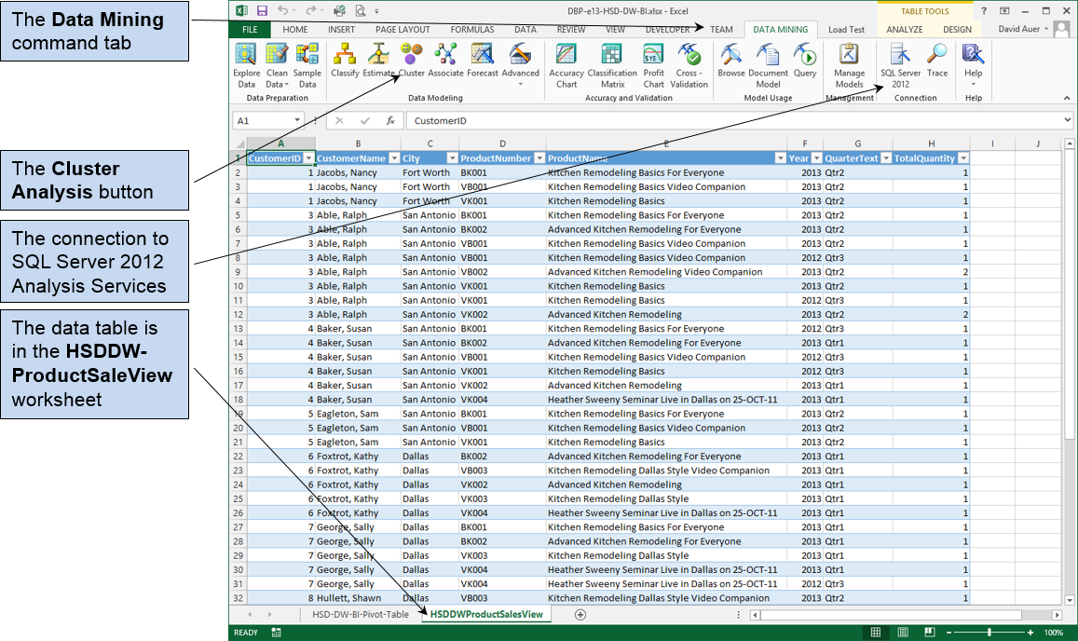
Excel Data Mining Add-In

Slide 31
Data Mining Applications: Popular Data Mining Techniques
Decision tree analysis—classifies entities into groups based on past history
Logistic regression—produces equations that offer probabilities that certain events will occur
Neural Networks—complex statistical prediction techniques
Market Basket Analysis—determines patterns of associated buying behavior

Slide 32
Data Mining Applications: Market Basket Analysis
Support—the probability that two items will be purchased together
Confidence—the probability that an item will be purchased given the fact that the customer has already purchased another particular item
Lift—the ratio of confidence to the basic probability that a particular item will be purchased

Slide 33
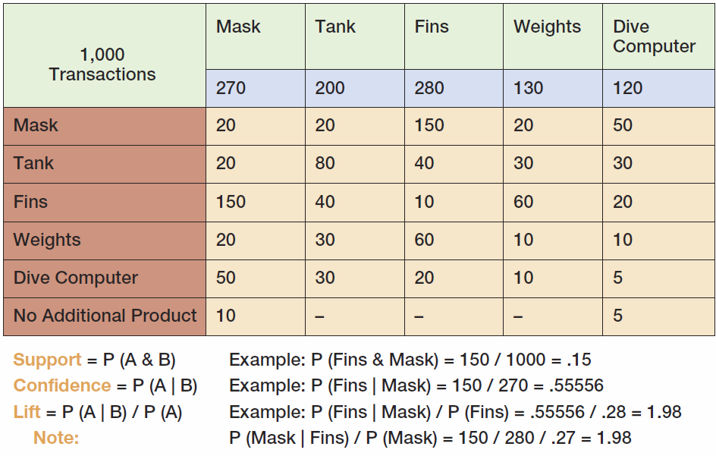
Data Mining Applications: Market Basket Analysis

Slide 34
David Kroenke and David Auer Database Processing Fundamentals, Design, and Implementation (13th Edition)
End of Presentation:
Chapter Thirteen

Slide 35

All rights reserved. No part of this publication may be reproduced, stored in a retrieval system, or transmitted, in any form or by any means, electronic, mechanical, photocopying, recording, or otherwise, without the prior written permission of the publisher. Printed in the United States of America.

